Slide 1
Chapter 9
Transaction Management and Concurrency Control

Slide 2
What is a Transaction?
Any action that reads from and/or writes to a database may consist of
  Simple SELECT statement to generate a list of table contents
  A series of related UPDATE statements to change the values of attributes in various tables
  A series of INSERT statements to add rows to one or more tables
  A combination of SELECT, UPDATE, and INSERT statements

Slide 3
What is a Transaction?
A logical unit of work that must be either entirely completed or aborted
Successful transaction changes the database from one consistent state to another
  One in which all data integrity constraints are satisfied
Most real-world database transactions are formed by two or more database requests
  The equivalent of a single SQL statement in an application program or transaction

Slide 4
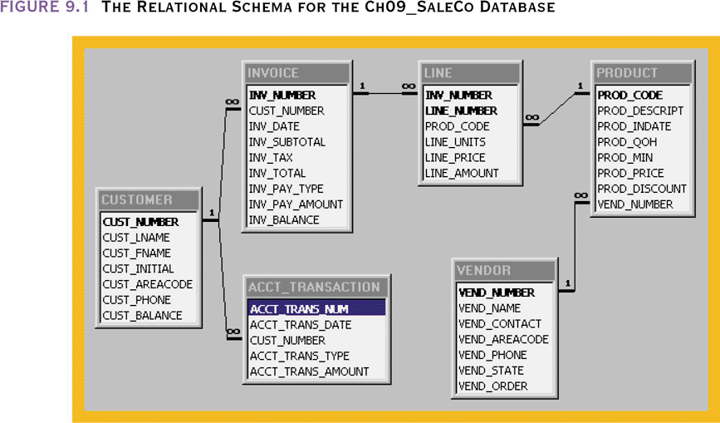
The Relational Schema for the Ch09_SaleCo Database

Slide 5
Evaluating Transaction Results
Not all transactions update the database
SQL code represents a transaction because database was accessed
Improper or incomplete transactions can have a devastating effect on database integrity
  Some DBMSs provide means by which user can define enforceable constraints based on business rules
  Other integrity rules are enforced automatically by the DBMS when table structures are properly defined, thereby letting the DBMS validate some transactions

Slide 6
Transaction Processing
For example, a transaction may involve
  The creation of a new invoice
  Insertion of an row in the LINE table
  Decreasing the quantity on hand by 1
  Updating the customer balance
  Creating a new account transaction row
If the system fails between the first and last step, the database will no longer be in a consistent state
Figure 9.2

Slide 7
Transaction Properties
Atomicity
  Requires that all operations (SQL requests) of a transaction be completed; if not, then the transaction is aborted
  A transaction is treated as a single, indivisible, logical unit of work
Durability
  Indicates permanence of database’s consistent state
  When a transaction is complete, the database reaches a consistent state. That state can not be lost even if the system fails

Slide 8
Transaction Properties
Serializability
  Ensures that the concurrent execution of several transactions yields consistent results
  Multiple, concurrent transactions appear as if they executed in serial order (one after another)
Isolation
  Data used during execution of a transaction cannot be used by second transaction until first one is completed

Slide 9
Transaction Management with SQL
ANSI has defined standards that govern SQL database transactions
Transaction support is provided by two SQL statements: COMMIT and ROLLBACK
ANSI standards require that, when a transaction sequence is initiated by a user or an application program,it must continue through all succeeding SQL statements until one of four events occurs

Slide 10
Transaction Management with SQL
A COMMIT statement is reached- all changes are permanently recorded within the database
A ROLLBACK is reached – all changes are aborted and the database is restored to a previous consistent state
The end of the program is successfully reached – equivalent to a COMMIT
The program abnormally terminates and a rollback occurs

Slide 11
The Transaction Log
Keeps track of all transactions that updatethe database. It contains:
  A record for the beginning of transaction
  For each transaction component (SQL statement)
    Type of operation being performed (update, delete, insert)
    Names of objects affected by the transaction (the name of the table)
    “Before” and “after” values for updated fields
    Pointers to previous and next transaction log entries for the same transaction
  The ending (COMMIT) of the transaction
Increases processing overhead but the ability to restore a corrupted database is worth the price

Slide 12
The Transaction Log
  Increases processing overhead but the ability to restore a corrupted database is worth the price
  If a system failure occurs, the DBMS will examine the log for all uncommitted or incomplete transactions and it will restore the database to a previous state
  The log it itself a database and to maintain its integrity many DBMSs will implement it on several different disks to reduce the risk of system failure

Slide 13
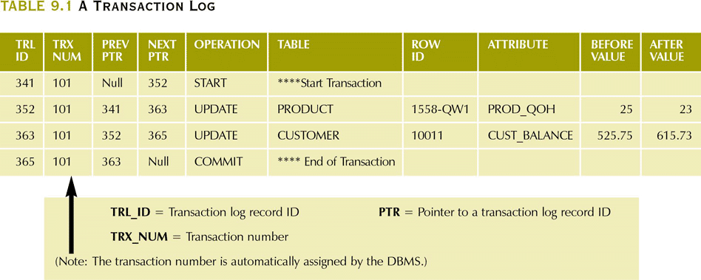
A Transaction Log

Slide 14
Concurrency Control
The coordination of the simultaneous execution of transactions in a multiprocessing database is known as concurrency control
The objective of concurrency control is to ensure the serializability of transactions in a multiuser database environment

Slide 15
Concurrency Control
  Important → simultaneous execution of transactions over a shared database can create several data integrity and consistency problems
  The three main problems are:
    lost updates
    uncommitted data
    inconsistent retrievals

Slide 16
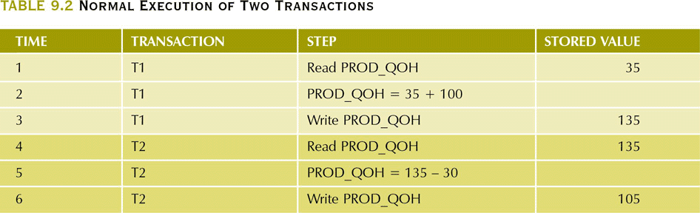
Normal Execution of Two Transactions

Slide 17
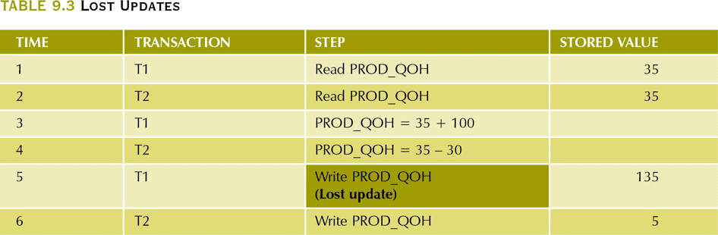
Lost Updates

Slide 18
Uncommited Data Problem
Uncommitted data occurs when two transactions execute concurrently and the first is rolled back after the second has already accessed the uncommitted data
  This violates the isolation property of transactions

Slide 19
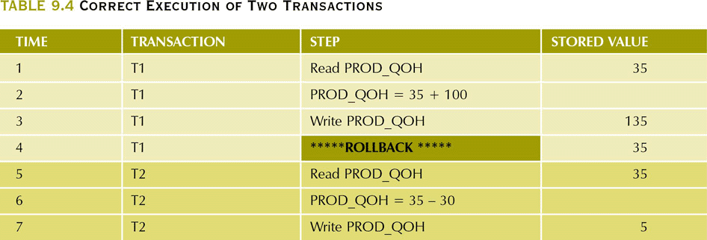
Correct Execution of Two Transactions

Slide 20
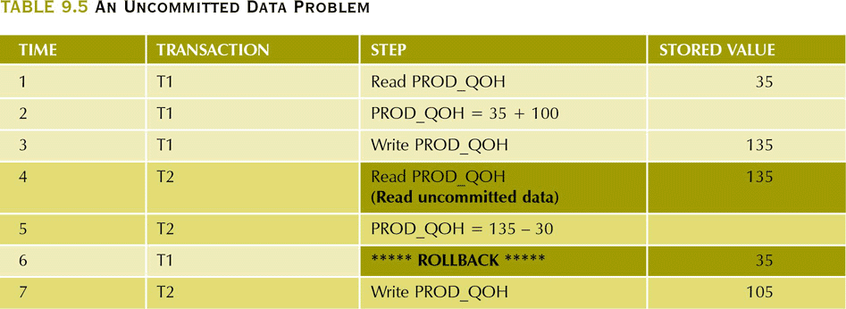
An Uncommitted Data Problem

Slide 21
Inconsistent Retrieval Problem
Occur when a transaction calculates some aggregate functions over a set of data while transactions are updating the data
  Some data may be read after they are changed and some before they are changed yielding inconsistent results

Slide 22
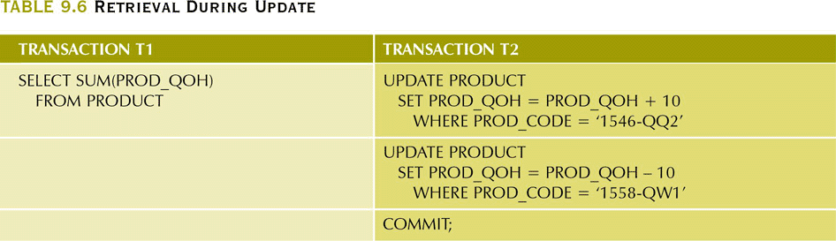
Retrieval During Update

Slide 23
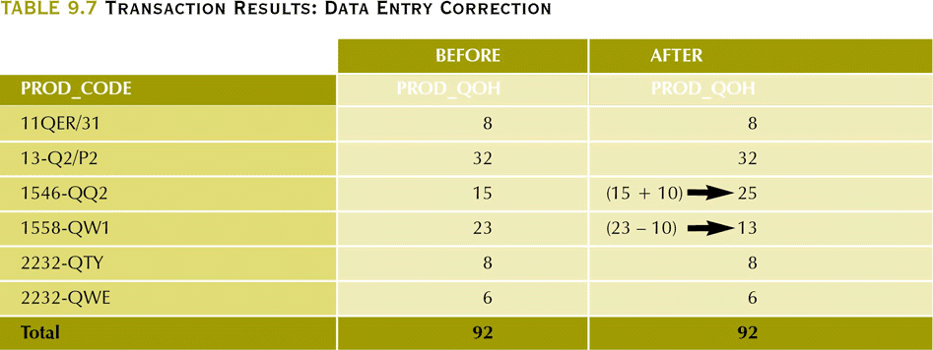
Transaction Results: Data Entry Correction

Slide 24
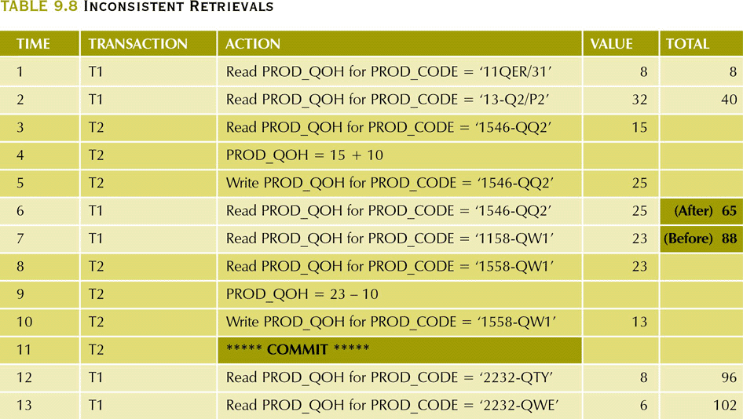
Inconsistent Retrievals

Slide 25
The Scheduler
Special DBMS program: establishes order of operations within which concurrent transactions are executed
Interleaves the execution of database operations to ensure serializability and isolation of transactions
  To determine the appropriate order, the scheduler bases its actions on concurrency control algorithms such as locking and time stamping

Slide 26
The Scheduler (continued)
Ensures computer’s central processing unit (CPU) is used efficiently
  Default would be FIFO without preemption – idle CPU (during I/O) is inefficient use of the resource and result in unacceptable response times in within the multiuser DBMS environment
Facilitates data isolation to ensure that two transactions do not update the same data element at the same time

Slide 27
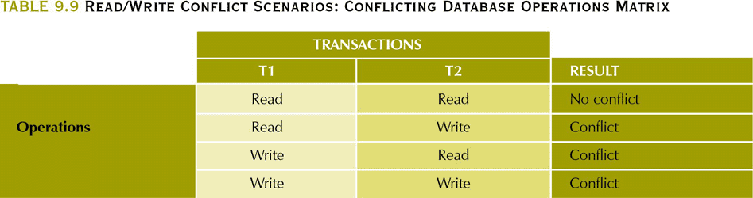
Read/Write Conflict Scenarios:
Conflicting Database Operations Matrix
Transactions T1 and T2 are executing concurrently over the same data
When they both access the data and at least one is executing a WRITE, a conflict can occur

Slide 28
Concurrency Control with Locking Methods
Lock
  Guarantees exclusive use of a data item to a current transaction
    T2 does not have access to a data item that is currently being used by T1
    Transaction acquires a lock prior to data access; the lock is released when the transaction is complete
  Required to prevent another transaction from reading inconsistent data
Lock manager
  Responsible for assigning and policing the locks used by the transactions

Slide 29
Lock Granularity
Indicates the level of lock use
Locking can take place at the following levels:
  Database-level lock
    Entire database is locked
  Table-level lock
    Entire table is locked
  Page-level lock
    Entire diskpage is locked
  Row-level lock
    Allows concurrent transactions to access different rows of the same table, even if the rows are located on the same page
  Field-level lock
    Allows concurrent transactions to access the same row, as long as they require the use of different fields (attributes) within that row

Slide 30
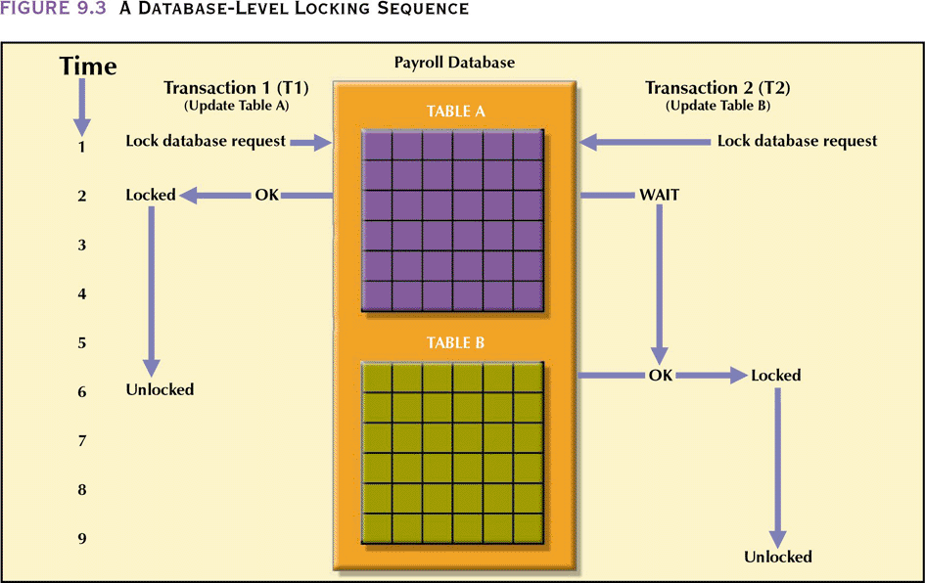
A Database-Level Locking Sequence
Good for batch processing but unsuitable for online multi-user DBMSs
T1 and T2 can not access the same database concurrently even if they use different tables

Slide 31
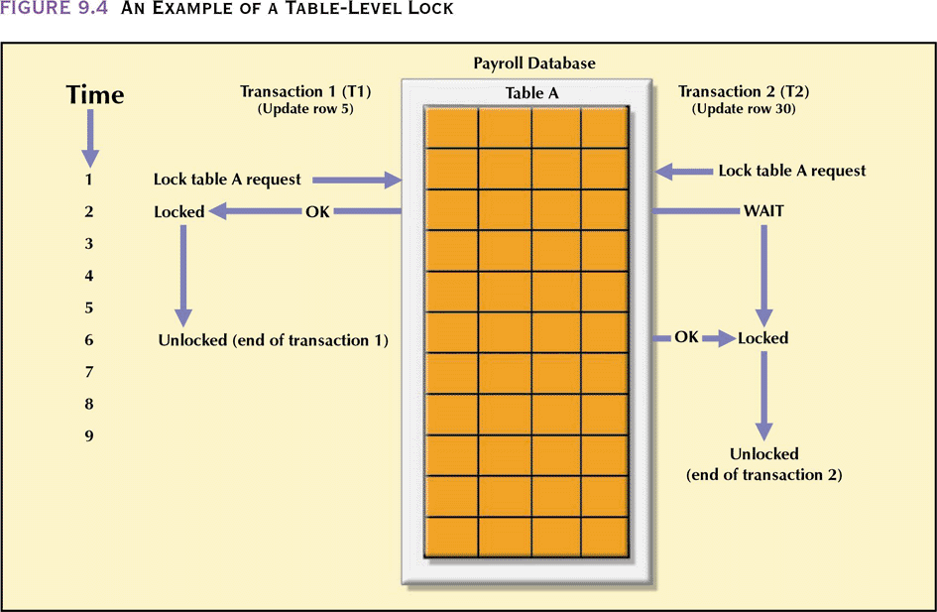
Table-Level Lock
T1 and T2 can access the same database concurrently as long as they use different tables
Can cause bottlenecks when many transactions are trying to access the same table (even if the transactions want to access different parts of the table and would not interfere with each other)
Not suitable for multi-user DBMSs

Slide 32
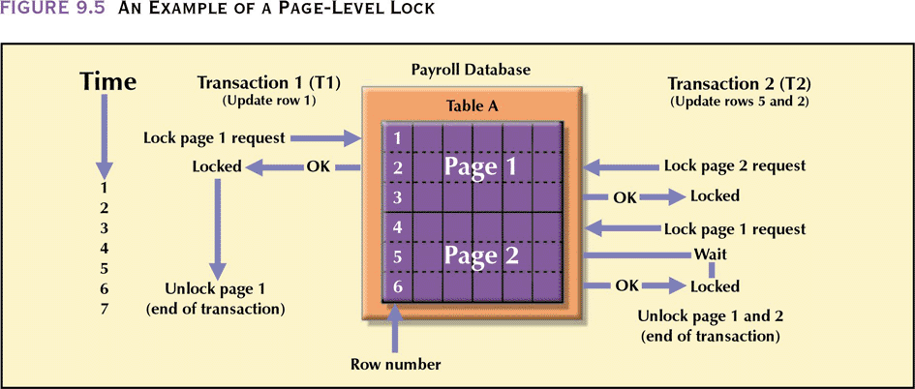
Page-Level Lock
An entire disk page is locked (a table can span several pages and each page can contain several rows of one or more tables)
Most frequently used multi-user DBMS locking method

Slide 33
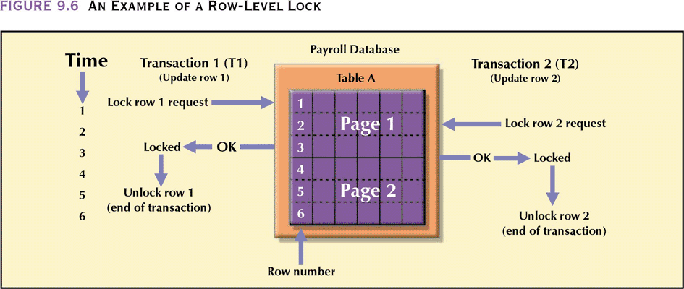
Row-Level Lock
Concurrent transactions can access different rows of the same table even if the rows are located on the same page
Improves data availability but with high overhead (each row has a lock that must be read and written to)

Slide 34
Field-Level Lock
Allows concurrent transactions to access the same row as long as they require the use of different fields with that row
Most flexible lock buy requires an extremely high level of overhead

Slide 35
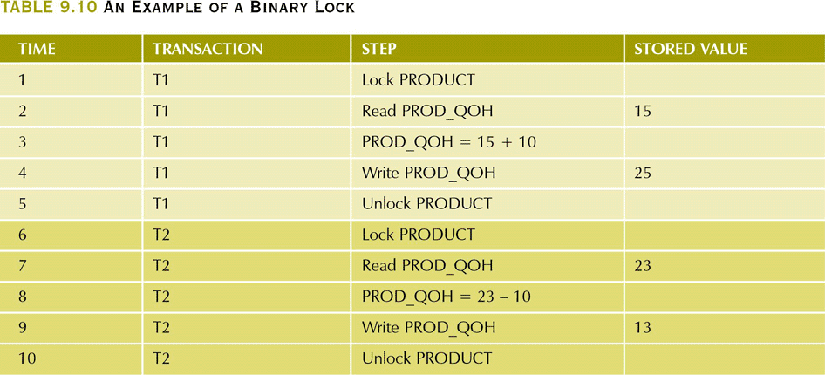
Binary Locks
Has only two states: locked (1) or unlocked (0)
Eliminates “Lost Update” problem – the lock is not released until the write statement is completed
  Can not use PROD_QOH until it has been properly updated
Considered too restrictive to yield optimal concurrency conditions as it locks even for two READs when no update is being done

Slide 36
Shared/Exclusive Locks
Exclusive lock
  Access is specifically reserved for the transaction that locked the object
  Must be used when the potential for conflict exists – when a transaction wants to update a data item and no locks are currently held on that data item by another transaction
  Granted if and only if no other locks are held on the data item
Shared lock
  Concurrent transactions are granted Read access on the basis of a common lock
  Issued when a transaction wants to read data and no exclusive lock is held on that data item
    Multiple transactions can each have a shared lock on the same data item if they are all just reading it
Mutual Exclusive Rule
  Only one transaction at a time can own an exclusive lock in the same object

Slide 37
Shared/Exclusive Locks
Increased overhead
  The type of lock held must be known before a lock can be granted
  Three lock operations exist:
    READ_LOCK to check the type of lock
    WRITE_LOCK to issue the lock
    UNLOCK to release the lock
  A lock can be upgraded from share to exclusive and downgraded from exclusive to share
Two possible major problems may occur
  The resulting transaction schedule may not be serializable
  The schedule may create deadlocks

Slide 38
Two-Phase Locking to Ensure Serializability
Defines how transactions acquire and relinquish locks
Guarantees serializability, but it does not prevent deadlocks
  Growing phase, in which a transaction acquires all the required locks without unlocking any data
  Shrinking phase, in which a transaction releases all locks and cannot obtain any new lock

Slide 39
Two-Phase Locking to Ensure Serializability
Governed by the following rules:
  Two transactions cannot have conflicting locks
  No unlock operation can precede a lock operation in the same transaction
  No data are affected until all locks are obtained—that is, until the transaction is in its locked point

Slide 40
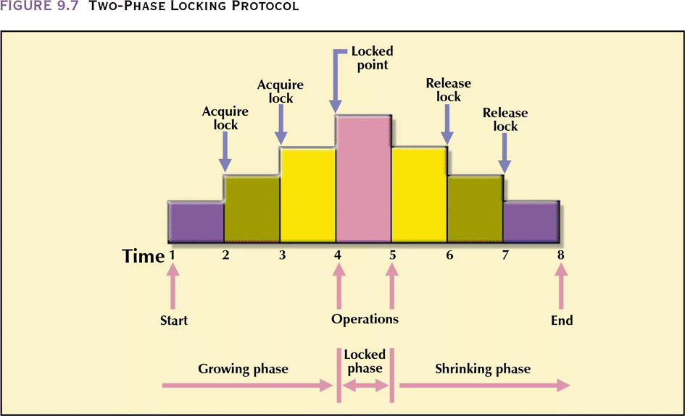
Two-Phase Locking Protocol

Slide 41
Deadlocks
Condition that occurs when two transactions wait for each other to unlock data
  T1 needs data items X and Y; T needs Y and X
  Each gets the its first piece of data but then waits to get the second (which the other transaction is already holding) – deadly embrace
Possible only if one of the transactions wants to obtain an exclusive lock on a data item
  No deadlock condition can exist among shared locks
Control through
  Prevention
  Detection
  Avoidance

Slide 42
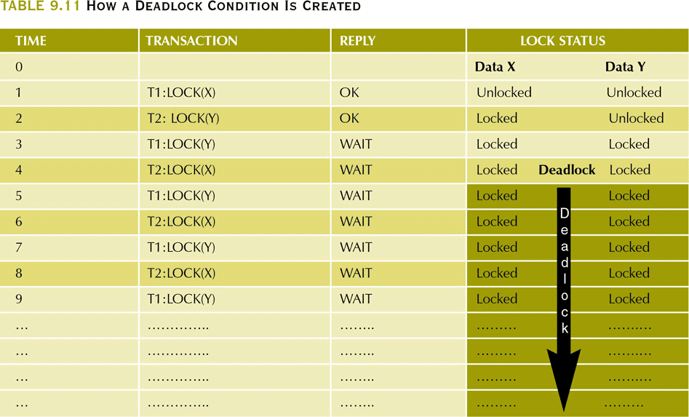
How a Deadlock Condition Is Created

Slide 43
Concurrency Control with Time Stamping Methods
Assigns a global unique time stamp to each transaction
  All database operations within the same transaction must have the same time stamp
Produces an explicit order in which transactions are submitted to the DBMS
Uniqueness
  Ensures that no equal time stamp values can exist
Monotonicity
  Ensures that time stamp values always increase
Disadvantage
  Each value stored in the database requires two additional time stamp fields – last read, last update

Slide 44
Wait/Die and Wound/Wait Schemes
Wait/die
  Older transaction waits and the younger is rolled back and rescheduled
Wound/wait
  Older transaction rolls back the younger transaction and reschedules it
In the situation where a transaction is requests multiple locks, each lock request has an associated time-out value. If the lock is not granted before the time-out expires, the transaction is rolled back

Slide 45
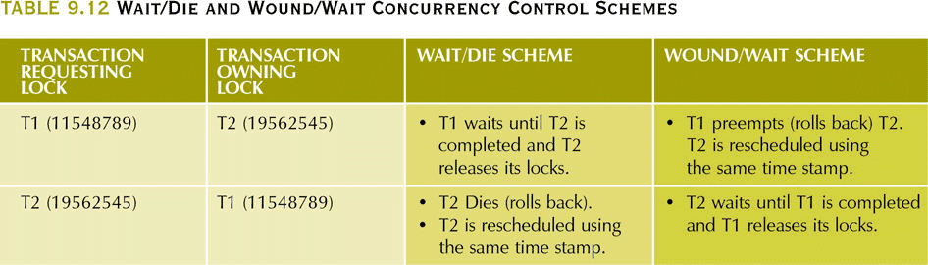
Wait/Die and Wound/Wait
Concurrency Control Schemes

Slide 46
Concurrency Control with Optimistic Methods
Optimistic approach
  Based on the assumption that the majority of database operations do not conflict
  Does not require locking or time stamping techniques
  Transaction is executed without restrictions until it is committed
  Acceptable for mostly read or query database systems that require very few update transactions
  Phases are read, validation, and write

Slide 47
Concurrency Control with Optimistic Methods
Phases are read, validation, and write
  Read phase – transaction reads the database, executes the needed computations and makes the updates to a private copy of the database values.
    All update operations of the transaction are recorded in a temporary update file which is not accessed by the remaining transactions
  Validation phase – transaction is validated to ensure that the changes made will not affect the integrity and consistency of the database
    If the validation test is positive, the transaction goes to the writing phase. If negative, the transaction is restarted and the changes discarded
  Writing phase – the changes are permanently applied to the database

Slide 48
Database Recovery Management
Database recovery
  Restores database from a given state, usually inconsistent, to a previously consistent state
  Based on the atomic transaction property
    All portions of the transaction must be treated as a single logical unit of work, in which all operations must be applied and completed to produce a consistent database
  If transaction operation cannot be completed, transaction must be aborted, and any changes to the database must be rolled back (undone)

Slide 49
Transaction Recovery
The database recovery process involves bringing the database to a consistent state after failure.
Transaction recovery procedures generally make use of deferred-write and write-through techniques

Slide 50
Transaction Recovery
Deferred write
  Transaction operations do not immediately update the physical database
  Only the transaction log is updated
  Database is physically updated only after the transaction reaches its commit point using the transaction log information
  If the transaction aborts before it reaches its commit point, no ROLLBACK is needed because the DB was never updated
  A transaction that performed a COMMIT after the last checkpoint is redone using the “after” values of the transaction log

Slide 51
Transaction Recovery
Write-through
  Database is immediately updated by transaction operations during the transaction’s execution, even before the transaction reaches its commit point
  If the transaction aborts before it reaches its commit point, a ROLLBACK is done to restore the database to a consistent state
    A transaction that committed after the last checkpoint is redone using the “after” values of the log
    A transaction with a ROLLBACK after the last checkpoint is rolled back using the “before” values in the log

Slide 52
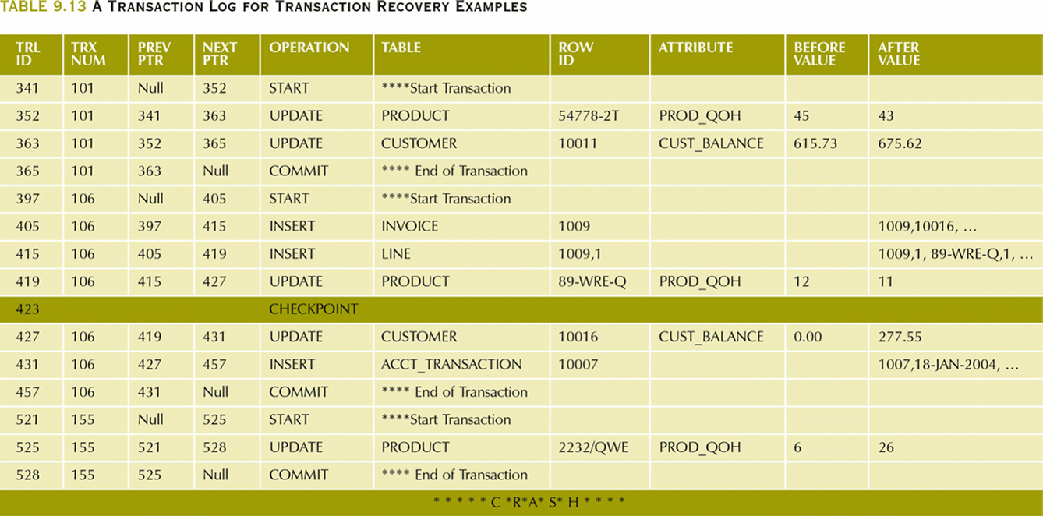
A Transaction Log for Transaction Recovery Examples

Slide 53
Transaction Recovery Examples
T101 consists of 2 UPDATE statements that reduce the QOH for product 54778-2T and increase the customer balance for customer 10011 for a credit sale of 2 units of that product
T106 represents a credit sale of 1 unit of 89-WRE-Q to customer 10016 for $277.55 This transaction consists of 3 INSERT and 2 UPDATE statements
T155 is an inventory update increasing QOH for 2232/QWE to 26 units
A DB checkpoint wrote all updated database buffers to disk which is only for T101

Slide 54
Transaction Recovery Examples
Last checkpoint was 423
T101 started and finished before that checkpoint so all changes were written to disk and no action need be taken
T106 and T155 committed after the last checkpoint so they will have their “after” values written to disk using the log

